Slide 1


The time is now:
Let’s talk about estate planning
Where there’s a will, there’s a way
The number of Americans with a will is declining.
Why do you need a will?
51%
32%
PROTECT YOUR LOVED ONES
IN 2005
Source: Gallup
IN 2021
Source: Caring.com
PROTECT YOUR ASSETS
What happens when you die …
WITHOUT A WILL
You die intestate. This is a fancy way of saying the courts decide what happens to your assets and your kids. The process is called probate, and it can sometimes costs thousands of dollars.
WITH A WILL
You go through probate, where a court validates everything. The information in your will becomes public record, and the process often costs money.
WITH A TRUST
The trust bypasses probate: Your information stays private, and the courts stay out of it.
This is the main reason we advocate for estate planning. It’s the best way to ensure your plans work out.

Slide 2
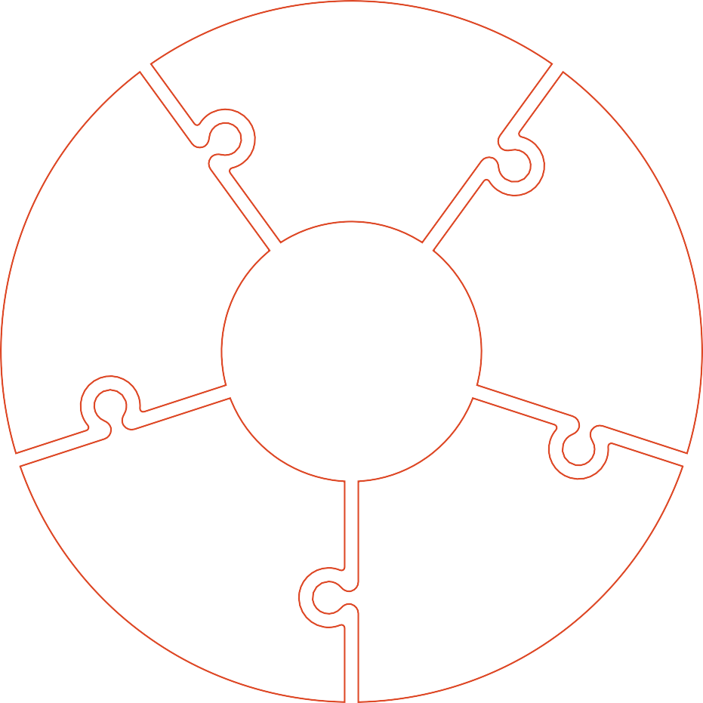

Build an estate plan with us
We work with EncorEstate Plans to build you a personalized plan that includes:
WILL TRUST
A legal document instructing what to do with your assets when you die.
You (the trustor) create a trust to hold your assets for a third party (beneficiary). These assets are under the care of a trustee.
Certifies that a trust exists and that the trustee has the right to act on behalf of the trust. Transfers assets held outside of the trust into it without transferring everything individually.
CERTIFICATION OF TRUST GENERAL TRANSFER
PROPERTY AGREEMENT (IF NEEDED)
FINANCIAL POWER OF ATTORNEY
MEDICAL POWER OF ATTORNEY/ ADVANCED HEALTH CARE DIRECTIVE
HIPAA RELEASE
Helps distinguish community property from individual property; this can be particularly relevant to married couples in certain states.
Gives someone (a trusted agent) authority to legally act on your behalf for financial matters.
Gives someone the authority to make medical decisions on your behalf if you are incapacitated or too ill to make your own decisions.
Grants specified people the ability to access your health records.
An estate plan is more than just a will, it covers …
These estate plan templates are built by attorneys in your state and reviewed by human estate planners before they are returned to you.
BENEFICIARIES:
Who will get your assets; these are your beneficiaries.
GUARDIANS:
If you have minor children, an estate plan covers who you want to take care of them.
THE
METHOD:
How your beneficiaries get those assets. (You could withhold your kids’ inheritance until they’re 18.)
Your information is protected:
BIG
5
Secure Sockets Layer (SSL)
Transport Layer Security (TLS)
One-way encryption
No one knows your password
CloudFlare Security Services
Protect data on the cloud
HEALTH CARE:
Decide who makes medical decisions for you if you’re unable, and give instructions.
DECISIONS:
A plan covers who makes financial decisions for you as the executor of your will, as a financial power of attorney, or as a trustee.

